Slide 1
Introduction to Statistics for Data Analytics
© Oluwatosin Oluwadare, Ph.D. 2024
Department of Computer Science , University of Colorado, Colorado springs.
CS 2020 and dase 2020
Introduction to statistics for data analystics
Spring 2024
Lecture 6: Regression I (cont’d)

Slide 2
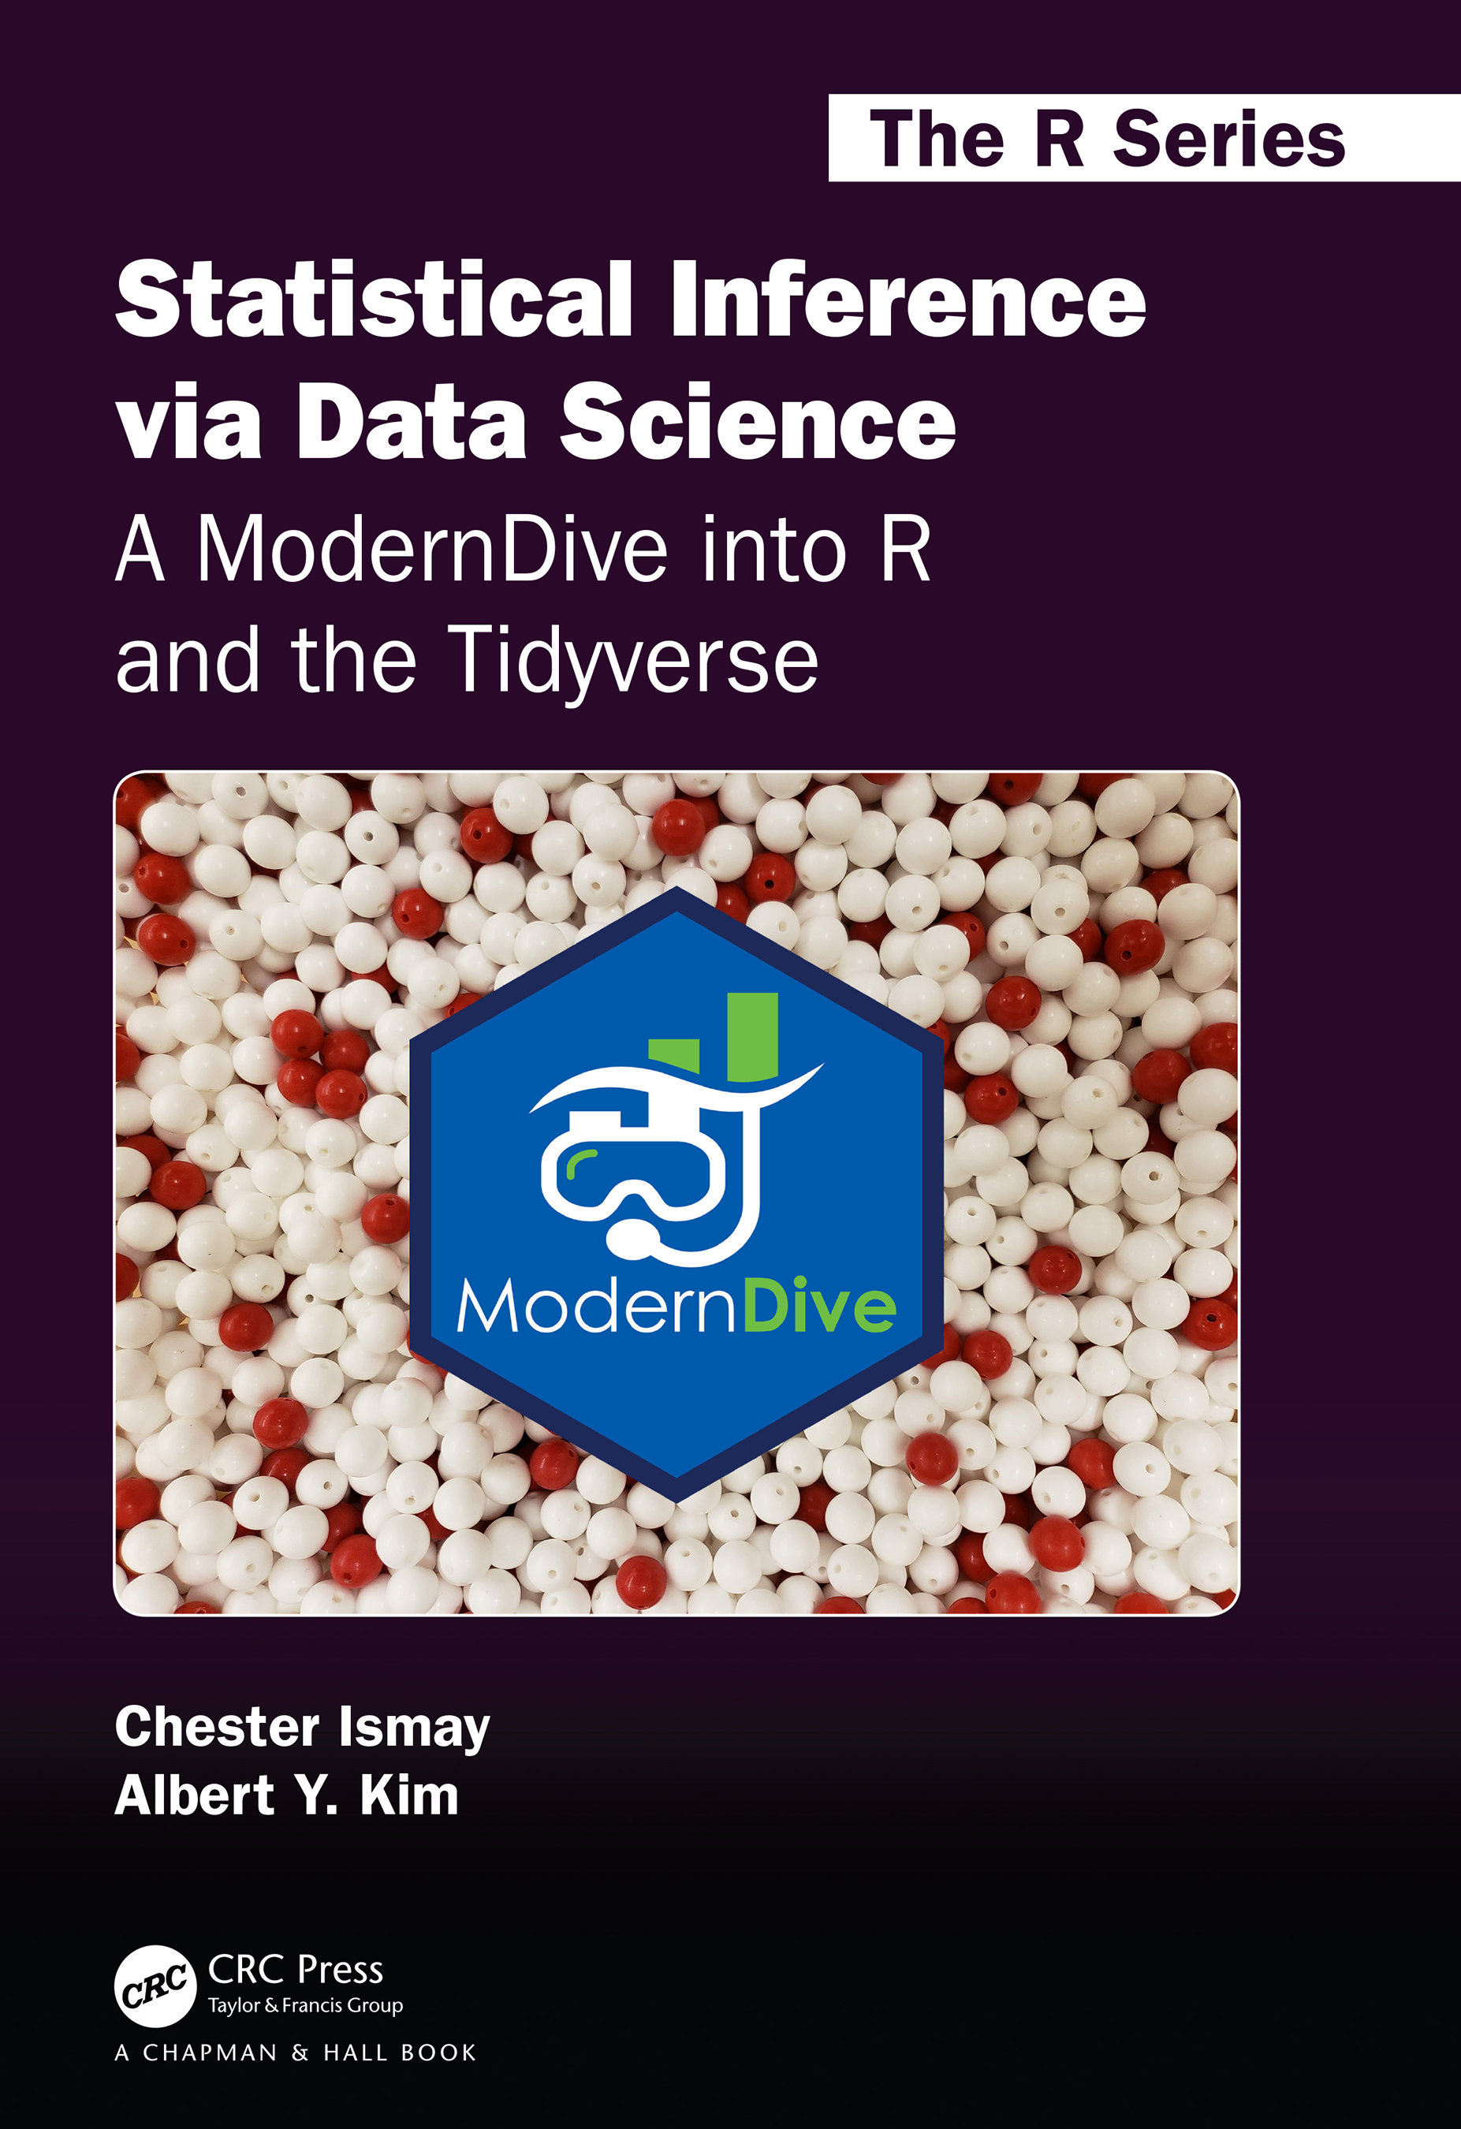
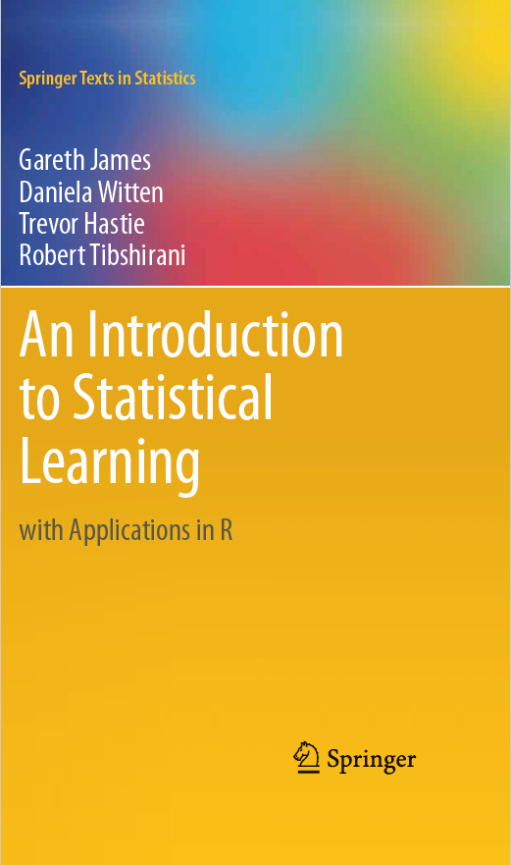
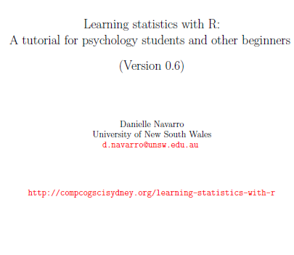
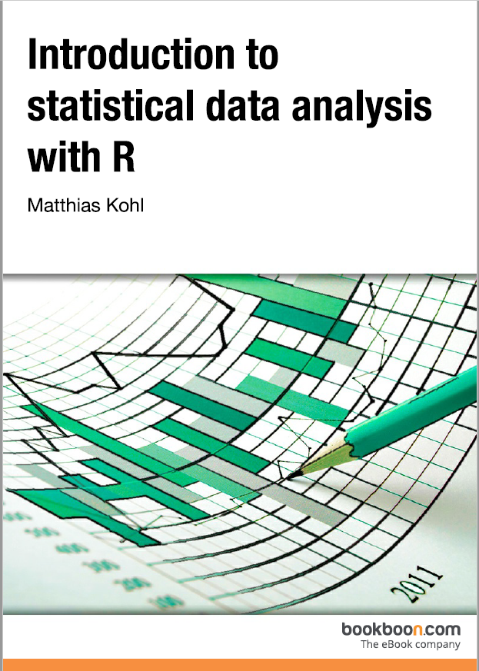
Credits
Our Main Textbook for the course:
  Ismay, Chester, and Albert Y. Kim. Statistical inference via data science: A ModernDive into R and the tidyverse. Chapman and Hall/CRC, 2019. Get an electronic copy from the UCCS Library. Or
  See open source copy of the textbook here: https://moderndive.com/ .
Some materials are from Michael Friendly
Stephanie Glen. "Inferential Statistics: Definition, Uses“
MiniTab
UCCS CS Dr. Adham Atyabi

Slide 3

Program Overview Details

Slide 4
Outline
Basic probability theory
The binomial distribution
The normal distribution
Other useful distributions

Slide 5
Probability
Statistics is there to help us draw inferences from data
The theory of statistical inference is built on top of probability theory.
here’s a tiny extract from a newspaper article in the Sydney Morning Herald (30 Oct 2010):
“I have a tough job,” the Premier said in response to a poll which found her government is now the most unpopular Labor administration in polling history, with a primary vote of just 23 per cent.

Slide 6

Probability $↔$ Statistics
Probability theory is “the doctrine of chances". It's a branch of mathematics that tells you how often different kinds of events will happen
  What are the chances of a fair coin coming up heads 10 times in a row?
  If I roll two six sided dice, how likely is it that I'll roll two sixes?
  How likely is it that five cards drawn from a perfectly shuffled deck will all be hearts?
  What are the chances that I'll win the lottery?
Probabilistic questions start with a known model of the world, and we use that model to do some calculations
Probabilities are just numbers that range from 0 to 1.
In probability theory, the model is known, but the data are not.
  That is the characteristics such as mean & standard deviation of the data which represents the data distribution cannot be altered
  Explaining the difference between probability and likelihood
Notes:
Probability corresponds to finding the chance of something given a sample distribution of the data, while on the other hand, Likelihood refers to finding the best distribution of the data given a particular value of some feature or some situation in the data.

Slide 7
Probability vs. Statistics
In statistics, we do not know the truth about the world. All we have is the data, and it is from the data that we want to learn the truth about the world.
  if my friend flips a coin 10 times and gets 10 heads, are they playing a trick on me?
  If five cards of the top of the deck are all hearts, how likely is it that the deck was shuffled?
  If the lottery commissioner's spouse wins the lottery, how likely is it that the lottery was rigged?
The statistical inference problem is to figure out which probability model is right for a problem.

Slide 8
Probability distributions
The key characteristic of elementary events is that every time we make an observation, then the outcome will be one and only one of these events.
The set of all possible events is called a sample space.
For an event X, the probability of that event P(X) is a number that lies between 0 and 1
The bigger the value of P(X), the more likely the event is to occur.
law of total probability: In probabilistic terms, is that the probabilities of the elementary events need to add up to 1

Slide 9
Distribution
There are many types of distributions, but the main 5 types are
  binomial distribution,
  normal distribution,
  t distribution,
  X² (“chi-square") distribution
  F distribution.

Slide 10


Binomial Distribution
The theory of probability originated in the attempt to describe how games of chance work

Slide 11
Binomial Distribution – Chalk discussion
Example 1: If a coin is tossed 5 times, using binomial distribution find the probability of:
(a) Exactly 2 heads (5/16)
(b) At least 4 heads. (3/16)
Example 2: 60% of people who purchase sports cars are men. Find the probability that exactly 7 are men if 10 sports car owners are randomly selected. ( 21.5%)

Slide 12
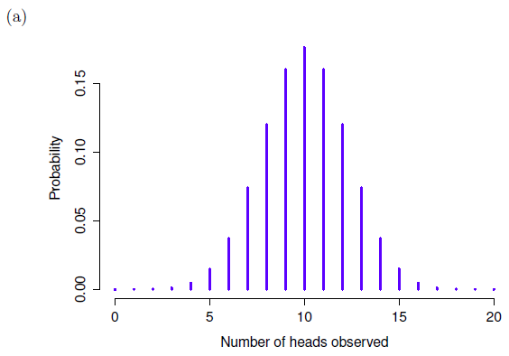
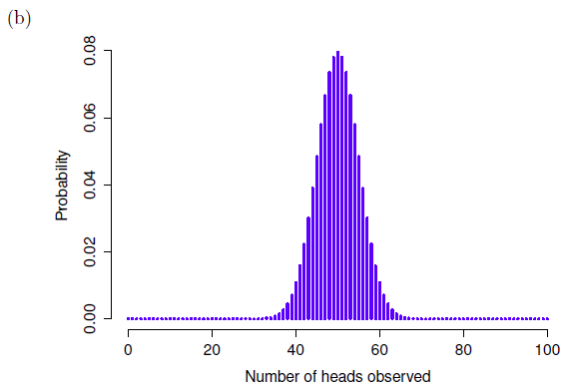
The binomial distribution in R
dbinom( x = 4, size = 20, prob = 1/6 )
[1] 0.2022036
Notes:
See simple exmaples here: https://www.cuemath.com/binomial-distribution-formula/

Slide 13
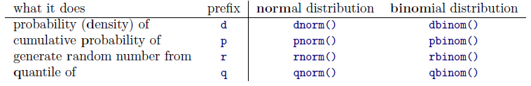
The binomial distribution in R
dbinom( x = 4, size = 20, prob = 1/6 )
[1] 0.2022036
pbinom( q= 4, size = 20, prob = 1/6)
[1] 0.7687492
qbinom( p = 0.75, size = 20, prob = 1/6 )
[1] 4
rbinom( n = 100, size = 20, prob = 1/6 )
[1] 3 4 8 4 4 3 1 4 4 1 3 0 3 3 4 3 1 2 2 3 4 2 2 1 2 4 4 3 5 4 2 3 1 2 7 4 2 5 2 3 0 2 3 3
[45] 2 2 2 3 4 4 2 0 2 4 4 3 4 1 2 3 5 3 7 5 0 5 1 5 4 3 4 4 1 5 4 4 3 2 3 3 4 5 0 5 1 4 7 2
[89] 5 1 1 2 4 5 5 3 3 3 3 3
Notes:
https://www.tutorialspoint.com/r/r_binomial_distribution.htm

Slide 14

The Normal distribution
Normal distribution, also known as “the bell curve” or a “Gaussian distribution”, is described using two parameters, the mean of the distribution μ and the standard deviation of the distribution σ.
The R functions for the normal distribution are dnorm(), pnorm(), qnorm() and rnorm()

Slide 15
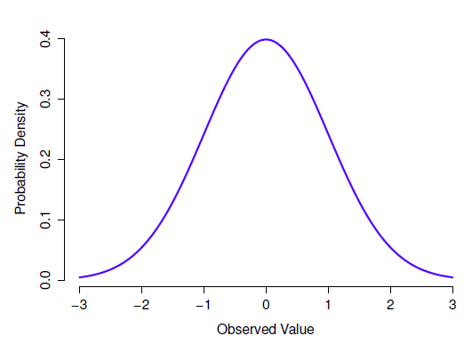
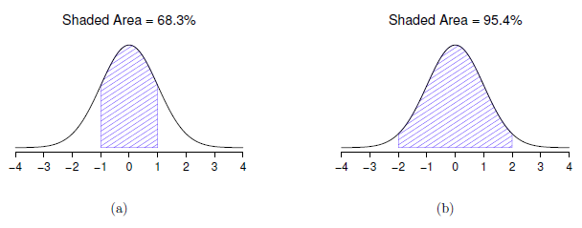
What it means for a variable to be normally distributed?

Slide 16
Probability Density
dnorm( x = 1, mean = 1, sd = 0.1 )
[1] 3.989423

Slide 17
Standardizing Numeric Data
Z-score:
  X: raw score to be standardized, μ: mean of the population, σ: standard deviation
  the distance between the raw score and the population mean in units of the standard deviation
  negative when the raw score is below the mean, “+” when above
An alternative way: Calculate the mean absolute deviation
  where
  standardized measure (z-score):
Using mean absolute deviation is more robust than using standard deviation

Slide 18
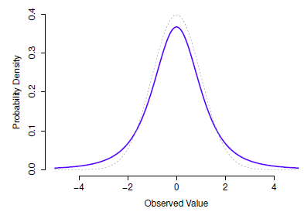
Other useful distributions: T-distribution
T-distribution is a continuous distribution that looks very similar to a normal distribution, but has heavier tails.
It is used for estimating population parameters for small sample sizes or unknown variances.
Details will be explained in hypothesis testing lecture
  R functions are dt(), pt(), qt() and rt()

Slide 19
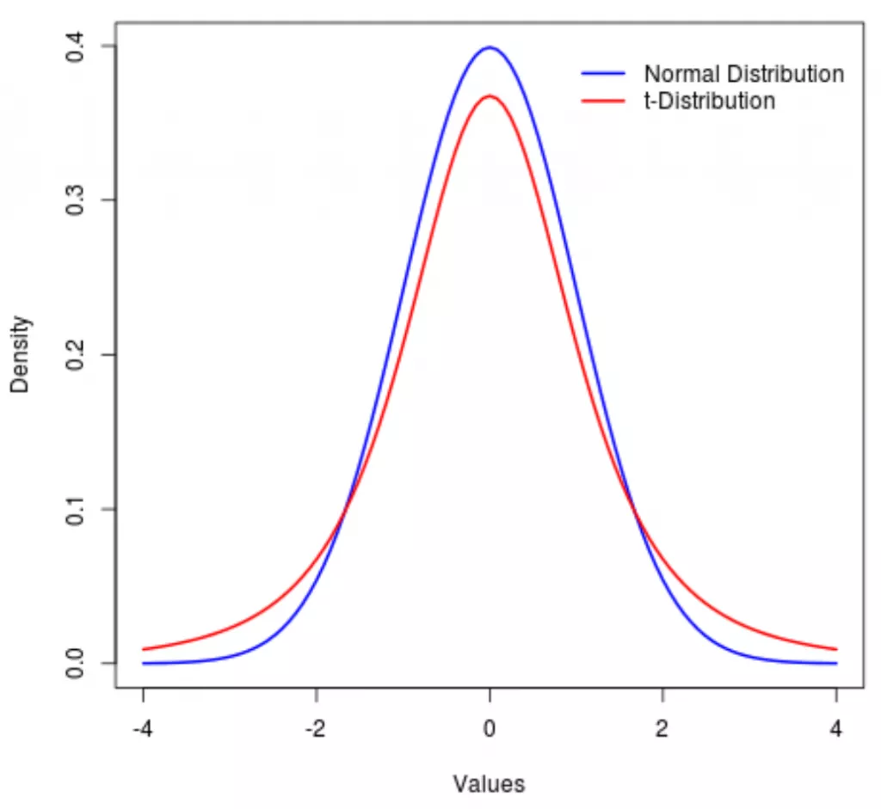
T-Distribution
T-distributions thus have higher kurtosis than normal distributions.
The probability of getting values very far from the mean is larger with a t-distribution than a normal distribution
Use if the population sample size is small and the standard deviation is unknown. If not, then the normal distribution should be used.
Notes:
https://www.investopedia.com/terms/t/tdistribution.asp

Slide 20
Other useful distributions: ᵡ² distribution
The R commands are chisq(), pchisq(), qchisq(), rchisq().
Notes:
You can use a chi-square goodness of fit test when you have one categorical variable. It allows you to test whether the frequency distribution of the categorical variable is significantly different from your expectations.

Slide 21
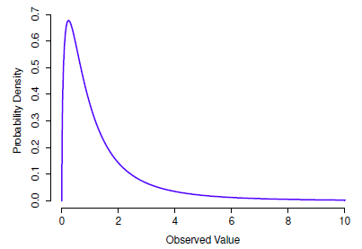
Other useful distributions: F distribution
The R commands are df(), pf(), qf() and rf().
Notes:
The F-distribution is used to determine if the variances of two populations are equal.

Slide 22
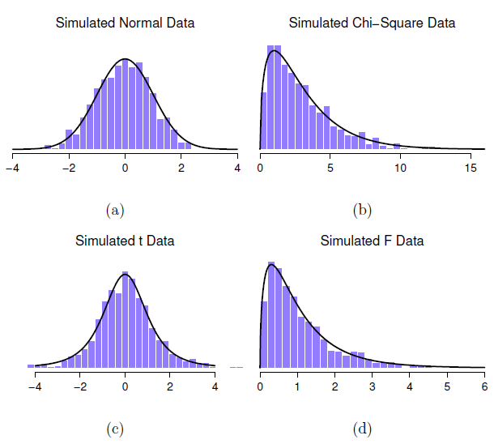
normal.a <- rnorm( n=1000, mean=0, sd=1 )
print(normal.a)
[1] 0.2913131706 -0.4156161554 0.1482611948 0.8516858463 -0.6658081840
[6] 0.8827940964 1.3757851963 0.2497812249 -0.1926513775 0.2160192605….
hist( normal.a )
normal.b <- rnorm( n=1000 )
normal.c <- rnorm( n=1000 )
chi.sq.3 <- (normal.a)^2 +
(normal.b)^2 +
(normal.c)^2
hist( chi.sq.3 )
scaled.chi.sq.3 <- chi.sq.3 / 3
normal.d <- rnorm( n=1000 )
t.3 <- normal.d / sqrt( scaled.chi.sq.3 )
chi.sq.20 <- rchisq( 1000, 20)
scaled.chi.sq.20 <- chi.sq.20 / 20
F.3.20 <- scaled.chi.sq.3 / scaled.chi.sq.20
hist( F.3.20 )

Slide 23
Regression I:
Regression with one Numerical Variable
Chapter 5:
Statistical Inference via Data Science

Slide 24
In Class Reading and Discussion
Today’s reading is Chapter 5: Regression I
Study in this order: Sections 5.3.1, 5.1.3, 5.3.2
Assigned time: 20-25 mins. 10:30 pm – 10:50pm
Review Points for discussion (10:50pm - 11:05 pm)
Chalk Talk Discussion
  Correlation and Causation (Review Spurious Correlations)
  Observed, fitted, residual
  Best fitting line

Slide 25
Learning Check(Submit Response on Canvas)
Describe the meaning of the residual value to a “newbie” in data analytics?
Create a new data from the evals data frame with the following five variables only: ID, age, cls_did_eval, cls_students and score. Generate a data frame of the residuals of the model with age as the explanatory variable and score as the outcome variable. Display the data frame using any data frame exploration function.
What does a larger sum of squares residuals imply? In contrast, a sum of squared residuals with the value zero means?
Compute the sum_of_squared_residuals for the residuals from question 2 above?

